Slide 1
Irony Detection in English Tweets
Group 15:
M S Nishanth CS18MTECH11005
Nikhil P Kumar CS18MTECH11017
Sharath R CS18MTECH11026

Slide 2
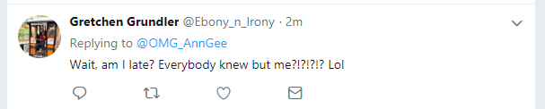
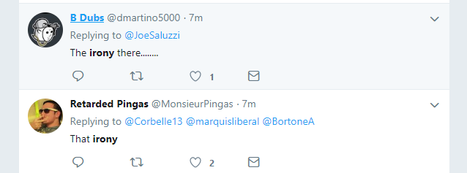
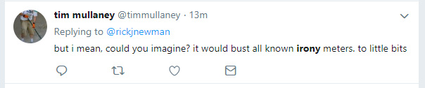
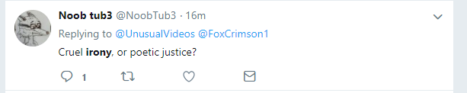
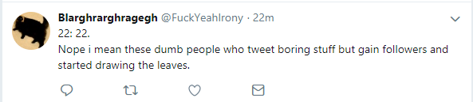


Slide 3
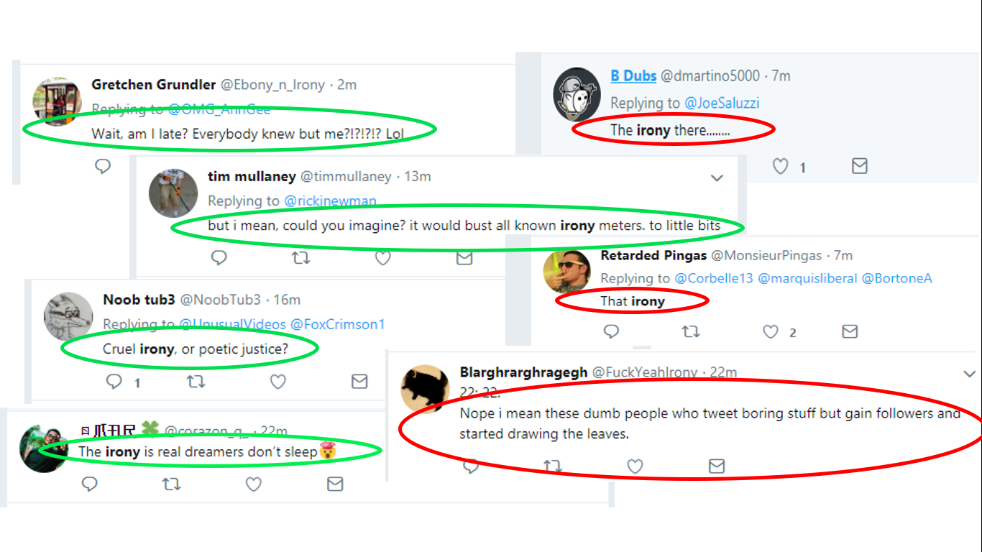

Slide 4
Introduction
The expression of one's meaning by using language that normally signifies the opposite, typically for humorous or emphatic effect.
Types:
Situational irony
Dramatic irony
Socratic irony
Verbal irony

Slide 5
Motivation
>> To build a stronger partnership between humans and machines. Moving to a world where the machines understand us, answering (and behaving) in the way a human would do.

Slide 6
Challenges
Irony introduce new challenges to many text-related tasks including information retrieval (IR), classiﬁcation, and clustering.
Mere identification of a word as polar (positive or negative) word is inadequate for fine-grained sentiment analysis which results beyond positive or negative.
There are many hidden properties of words other than being positive or negative which can lead to enrichment of existing sentiment analysis.
This work focuses on finding these properties in polar words in light of different applications of sentiment analysis.

Slide 7
Problem Definition
P1: To predict if a given text is ironic or not.
P2: We next try to find the category of irony
verbal irony realized through a polarity contrast,
verbal irony without such a polarity contrast
descriptions of situational irony
non-irony

Slide 8
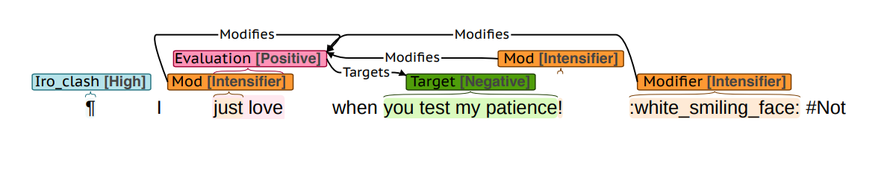
Brat annotation

Slide 9
Approaches
Rule Based Approach : It attempts to identify sarcasm through specific evidences captured in terms of rules that rely on indicators of sarcasm.
Statistical Approach : Statistical approaches to irony detection vary in terms of features and learning algorithms. Most of the approaches use bag-of-words as features.
Deep Learning based Approach : The use of architectures based on deep learning can be used to get an improvement in performance.

Slide 10
Architecture
Feature Engineering
Training Data
Lexical Features
Syntactic features:
Lexical Features
Syntactic features:
Pre-Processing
Annotated Label
Modelling
Test Data
LIBSVM
SVM
Classification

Slide 11
Feature Engineering
We extracted the a number of features from the dataset. These features would help us explain the tweets to machine in a better way.
Lexical features
Syntactic features
Sentiment features
Semantic features

Slide 12
Lexical features:
Bags-of-words (BoW) features.
token bigrams
Character flooding
Punctuation flooding
Capitalization
Hashtag frequency
Hashtag-to-word ratio
Emoticon frequency
Tweet length.

Slide 13
Syntactic features :
For each PoS tag:
whether it occurs in the tweet or not.
whether the tag occurs 0, 1, or > 2 times.
The frequency of the tag .
The number of interjections.
For each Named entity:
named entity present or not.
the number of named entities in the text.
the number of tokens part of named entity.
frequency of tokens that are part of a named entity.

Slide 14

Sentiment features :
AFINN (Nielsen, 2011)
MPQA (Wilson et al., 2005)
General Inquirer (GI) (Stone et al., 1966)
NRC Emotion Lexicon (Mohammad and Turney, 2013)
Bing Liu (Minqing Hu and Bing Liu. 2004)
For each lexicon
number of positive, negative and neutral lexicons.
the overall tweet polarity.
the absolute difference.
a binary feature indicating whether there is a polarity .
The sentiment lexicon features were extracted in two ways:
by considering all tokens in the instance.
by considering only hashtag tokens.

Slide 15
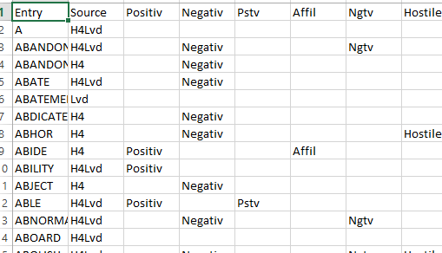
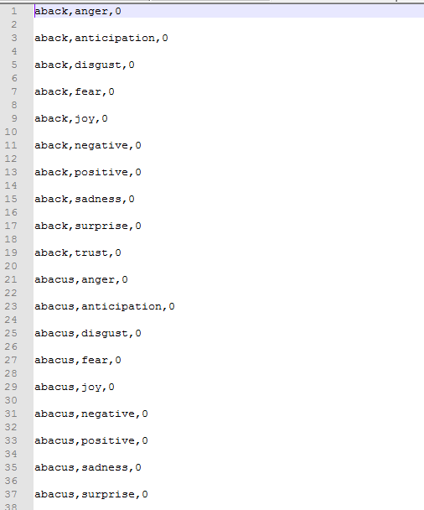
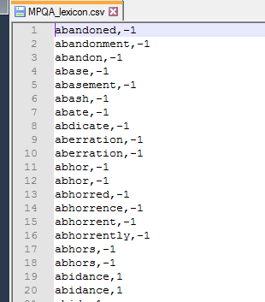

Slide 17
“I just love when you test my patience!”
What sort of emotion does it convey?

Slide 18
Semantic feature:
used word embedding cluster features generated with Word2Vec (Mikolov et al., 2013).
In this word embedding's, are the distributed vector representation of words that capture the syntactic and semantic relationships among words.
Maps Love and Hate together.

Slide 19
Corpus Collection for Word2Vec
from Twitter: API key, API secret, Access token and Access token secret.
Collect the API keys and create your access token via twitter acc.
A python library called Tweepy to download the corpus wrt hastag and time stamp.
Hash tags:
#irony, #sarcasm, #not, #sarcastic, #ironic.

Slide 20
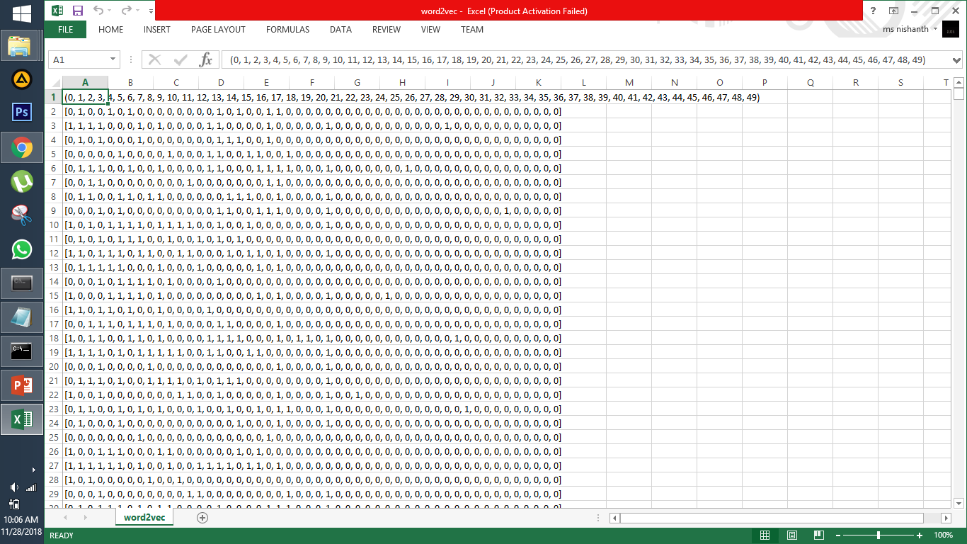

Slide 21
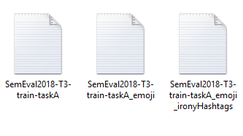
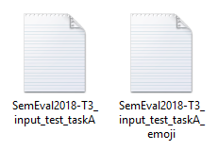
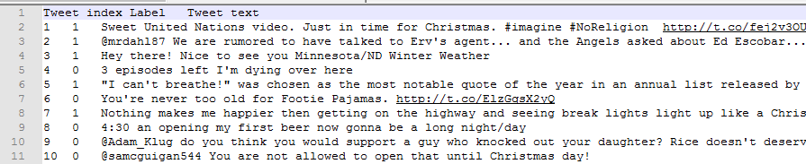
DataSet

Slide 22
Experiment
Preprocessing
We normalized hyperlinks and @-replies/mentions to http://someurl and @someuser, respectively.
Other preprocessing steps involve tokenization and lemmatization.
Extracted Features
Lexical features - 7
Syntactic features - 82
Sentiment features -16*5
Semantic features - 50

Slide 23
Model Training
For Binary Classification:
SVM
Naïve Bayes
For Multi-Class
LIBSVM
Naïve Bayes
Neural Network

Slide 24
Results
Sentiment Analysis (TEST A)

Slide 25
Results
F1-Score (TEST A)

Slide 26
Result Comparison with Paper(Set A)

Slide 27
Sentiment Analysis (TEST B)

Slide 28
Result comparison with paper(Set B)

Slide 29
Future Study
Using result of P1 to get better result for P2.
GloVe Embedding for Semantic Feature
LDA to group word Embedding.

Slide 30
References
Van Hee,C., Lefever, E., and Hoste, V. (2016). Exploring the Automatic Recognition of Irony in English tweets
Van Hee,C., Lefever, E., and Hoste, V. (2016). Exploring the Realization of Irony in Twitter Data
Joshi, A., Bhattacharyya, P., Carman, M. (2016). Automatic Sarcasm Detection: A Survey

Slide 31
THANK YOU

